Slide 1
CSE 1121 Structured and Object Oriented Programming Language Department of Computer Science and Engineering DUET, Gazipur-1700
Md. Abu Bakkar Siddique
Lecturer, Department of CSE, DUET
Room # 7024, New Academic Building
Phone/Mobile: +880249274034-53 Ext: 3281, +8801944275646
Email: absiddique@duet.ac.bd, absduet@gmail.com

Slide 2
Lecture 06(Array)
Introduction to Array
One-Dimensional Array
Multidimensional Array

Slide 3
Array
Collection of data elements of the same type that are referred through a common name.
Group of memory locations in which all have the same name and same type.
And these locations are contiguous.
A specific element in an array is accessed by an index/subscript.
Index must be an integer number and starts at zero.
Arrays, like other variables in C, must be declared before they can be used.

Slide 4
One dimensional Array
Single subscript is required to reference an element of the array.
Index set consists of n-consecutive integer number.
If array size is n, then in C index set consists of 0,1,2,3, . . . . . ., n-1
Elements of the array are stored in consecutive memory locations.
Declaration format:
data_type variable_name[size];
Example:
int number[5];
Array Initialization
int number[5] = {6, 5, 7, 2, 9};
number[0] = 6;
number[1] = 5;
number[2] = 7;
number[3] = 2;
number[4] = 9;
Memory Representation
index memory number[0]
6
5
7
2
9
number[1] number[2]
number[3] number[4]

Slide 5
One dimensional Array
int number[5] = {6, 5, 7, 2, 9};
loc(number[k]) = base(number) + w * k;
Where,
w = number of byte per storage location k = index of element
base(number) = base address of number
index memory number[0]
address
1000
6
5
7
2
9
. . . .
number[1] number[2]
1004
1008
number[3] number[4]
1012
1016
example:
loc(number[3]) = 1000 + 4* 3
= 1012

Slide 6
One dimensional Array
Read the marks of 5 students of a class and calculate the average marks.
#define STUDENT 5
void main()
{
float marks[STUDENT], average = 0.0, summation = 0.0; int counter;
for(counter = 0; counter < STUDENT; counter++)
scanf(“%f”, &marks[counter]);
for(counter = 0; counter < STUDENT; counter++)
summation = summation + marks[counter];
average = summation / STUDENT;
printf(“Average Marks: %f”, average);
}

Slide 7
Two dimensional Array
Two subscript is required to reference an element of the array.
Elements of the array are stored in consecutive memory locations.
Size of the two-dimensional array is denoted by m×n and pronounced as m by n.
Declaration format:
data_type variable_name[row_size][col_size];
Example:
int number[3][3];

Slide 8
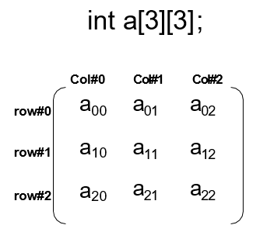
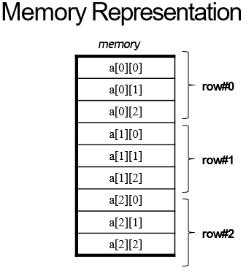
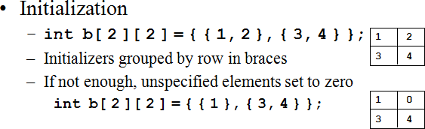
Two dimensional Array

Slide 9
Two dimensional Array
int a[3][3]; | Memory address
a[0][0] | 1000
a[0][1] | 1004
a[0][2] | 1008
a[1][0] | 1012
a[1][1] | 1016
a[1][2] | 1020
a[2][0] | 1024
a[2][1] | 1028
a[2][2] | 1032
loc(a[r][c]) = base(a) + w(n× r + c)
Where,
w = number of byte per storage location
(r, c) = index of element
base(a) = base address of array ‘a’
example:
loc(a[2][2]) = 1000 + 4 (3 × 2 + 2)
= 1032

Slide 10
Two dimensional Array(Example)
Read the marks of 5 subjects of each of the 10 students of a class. Display the average marks for each students of the class.
#define STUDENT 10
#define SUBJECT 5
for(counter1= 0; counter1 < STUDENT; counter1++)
{
printf(“\nEnter Marks of Student[%d]=”, counter1 + 1);
for(counter2= 0; counter2 < SUBJECT; counter2++)
scanf(“%f”, &marks[counter1][counter2]);
}
printf(“Student#\tAvgMarks”);
for(counter1 = 0; counter1 < STUDENT; counter1++)
{
printf(“\n%d”, counter1+1);
for(counter2= 0; counter2 < SUBJECT; counter2++)
{
summation += marks[counter1][counter2];
}
average = summation/STUDENT;
printf(“\t%f”, average);
}

Slide 11
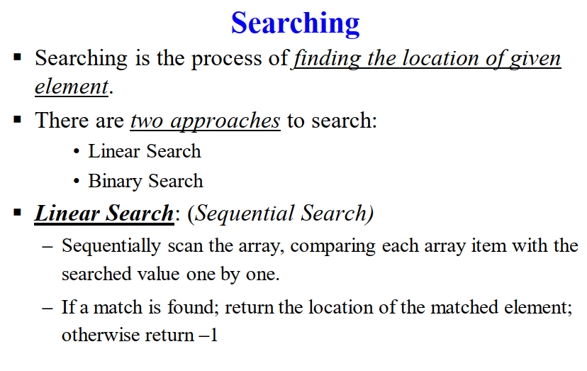

Slide 12
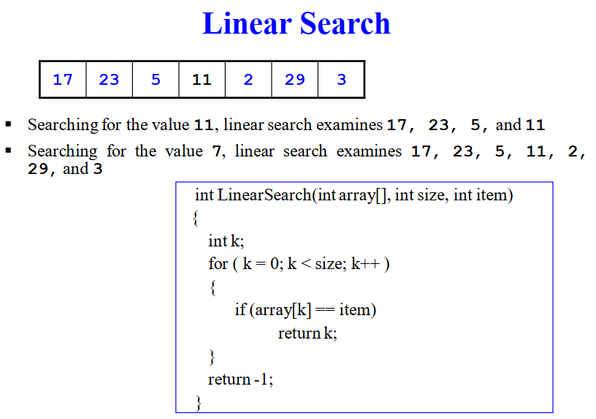

Slide 13
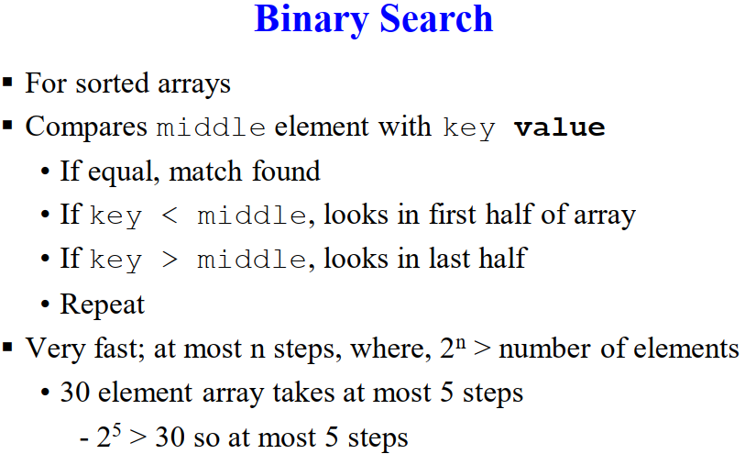

Slide 14
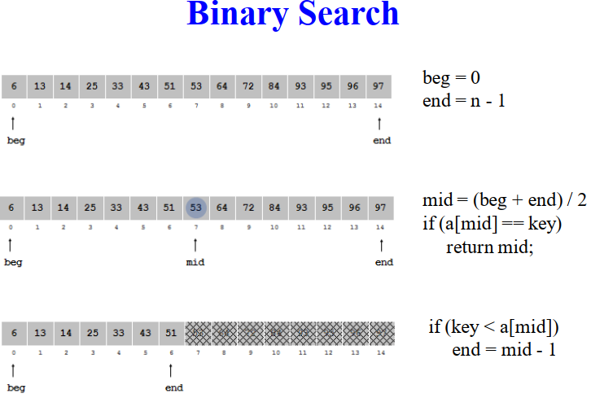

Slide 15
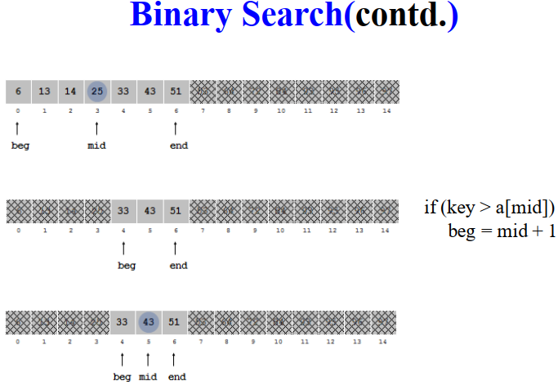

Slide 16
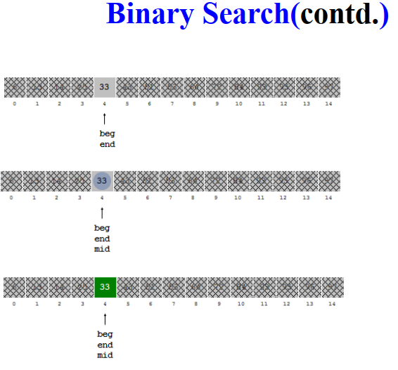

Slide 17
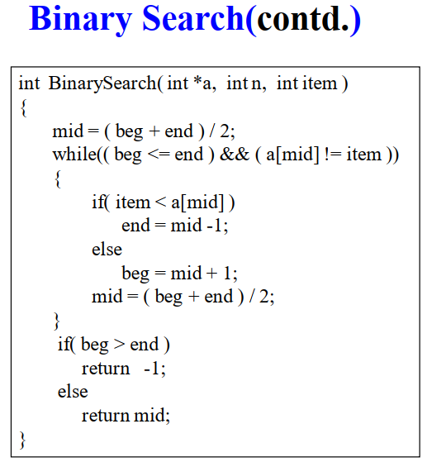

Slide 18
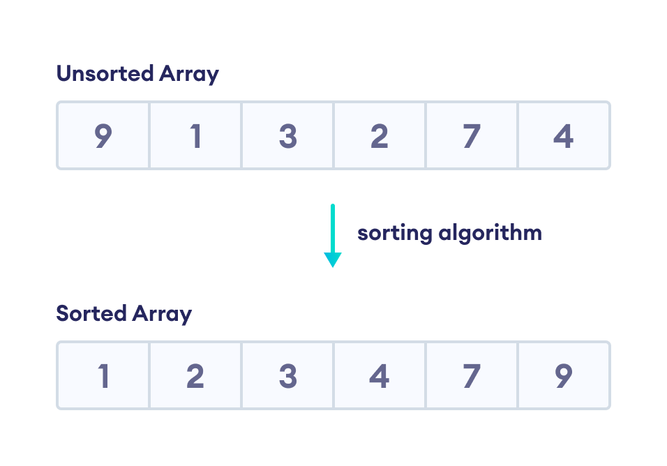
Sorting
Sorting is used to arrange elements of an array/list in a specific order. For example

Slide 19
Bubble Sort
Bubble sort is a sorting algorithm that compares two adjacent elements and swaps them until they are in the intended order.
Just like the movement of air bubbles in the water that rise up to the surface, each element of the array move to the end in each iteration. Therefore, it is called a bubble sort.
Working of Bubble Sort
Suppose we are trying to sort the elements in ascending order.
1. First Iteration (Compare and Swap)
Starting from the first index, compare the first and the second elements.
If the first element is greater than the second element, they are swapped.
Now, compare the second and the third elements. Swap them if they are not in order.
The above process goes on until the last element.

Slide 20
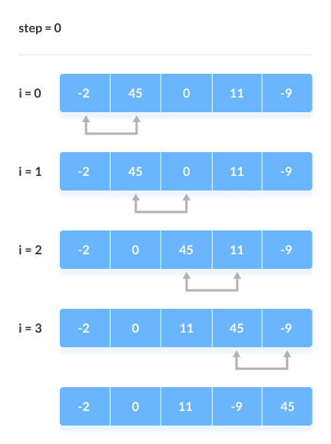
Bubble Sort

Slide 21
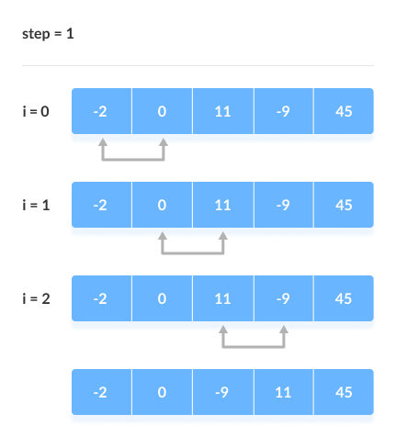
Bubble Sort
2. Remaining Iteration
The same process goes on for the remaining iterations.
After each iteration, the largest element among the unsorted elements is placed at the end.

Slide 22
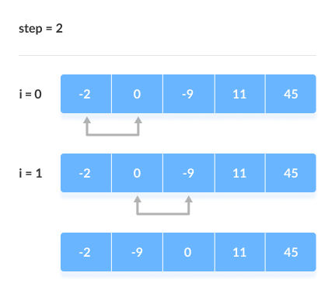
Bubble Sort
3.
In each iteration, the comparison takes place up to the last unsorted element.

Slide 23
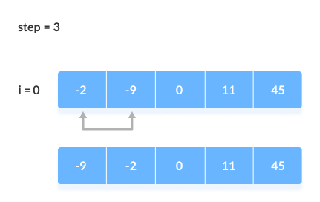
Bubble Sort
4.
The array is sorted when all the unsorted elements are placed at their correct positions.

Slide 24
Bubble Sort
#include <stdio.h>
void bubbleSort(int array[], int size) {
for (int step = 0; step < size - 1; ++step) {
for (int i = 0; i < size - step - 1; ++i) {
if (array[i] > array[i + 1]) {
int temp = array[i];
array[i] = array[i + 1];
array[i + 1] = temp;
} }
}}
// print array
void printArray(int array[], int size) {
for (int i = 0; i < size; ++i) {
printf("%d ", array[i]);
}
printf("\n");
}
int main() {
int data[] = {-2, 45, 0, 11, -9};
int size = sizeof(data) / sizeof(data[0]);
bubbleSort(data, size);
printf("Sorted Array in Ascending Order:\n");
printArray(data, size);
}

Slide 25

Any Question?

Slide 26
Thank You All !

